Slide 1
R in business
Kamil Sijko

Slide 2
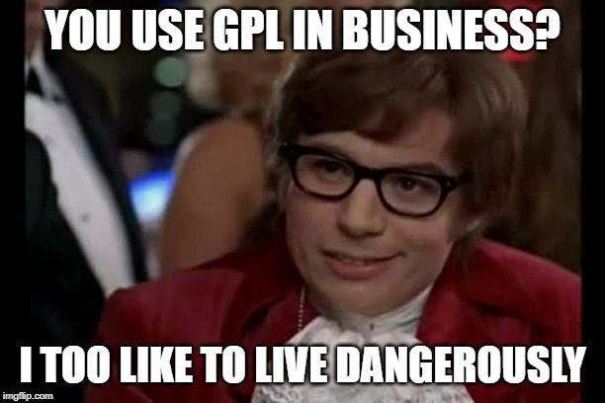

Whoa!
R is licensed:
R: GPL-2 | GPL-3
packages: GAGPL, BSD, LGPL, MIT, CA-SA i inne
Rstudio: AGPL / Commercial
Shiny: GPL-3

Slide 3
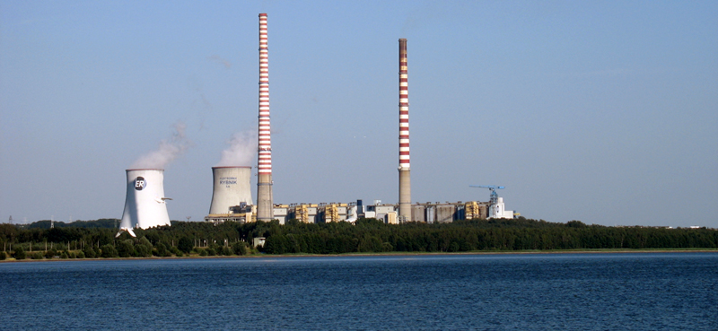

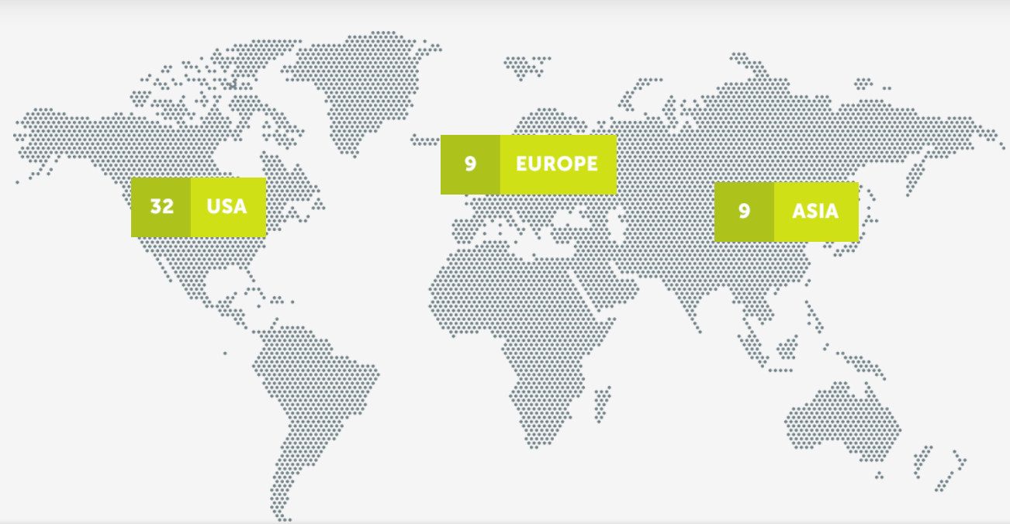
Optimization of continuous processes: IVY / SILO
CLIENT EDF Poland, Rybnik Power Station (and 150+ worldwide)
PROBLEM Coal combustion constitutes one of the biggest operational costs for power plants.
SOLUTION
IVY and SILO are our predictive cotrollers.
They use Artificial Neural Networks, Artificial Immunological Layer and Fuzzy Logic to optimize the combustion proces.
OUTCOME
0.27% better efficacy
Less equipment stress
$300k saved yearly
4380 tons of CO₂ less ($22k USD saved)
1565 tons of coal less ($140k saved)
665 tons of ammonia less ($135k saved)

Slide 4


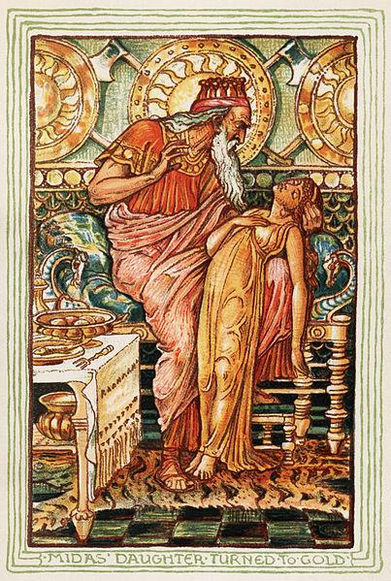
GPL vs Business (VRIO)
Freedom:
0: to run the program as you wish, for any purpose
1: to study how the program works, and change it
2+3: to redistribute copies, also of your modified versions
Copyleft: derivative work must be open-source and distributed under the same license terms
"Liberty or Death”: can’t avoid publishing

Slide 5
What works for others?
Many companies collaborate on product: Linux
Internal use
Bundle
With hardware (smart TVs, cars)
With software (Google’s Android)
Support, professional services, addons (RedHat, RStudio)
Obfuscation of source code
Notes:
Mature Open Software: bulletproof

Slide 6
How about Data Science?
Internal use
Source Data doesn’t have to be redistributed
Models are treated as data derivative
(we are not artists but craftsmans ☹)
Modularization (APIs)
Scripts do not fall under GPL (vide Perl case @ GPL FAQ)
B2B sales: only customer needs to get the code, you can sign NDA

Slide 7
Thanks!
Does anyone have any questions?
kamil@sijko.pl
Transition Technologies S.A.

